Slide 1

Disease Surveillance & Recovery Report
Present By :- Sarthak Salvi

Slide 2

Objective of the Project
To monitor disease spread, recovery, and impact across Indian states using patient data.
Goal :-
To monitor disease spread, recovery and impact across Indian states using patient data.
Scope :-
Track patient demographics
Identify trends by state, gender, age
Evaluate recovery outcomes

Slide 3
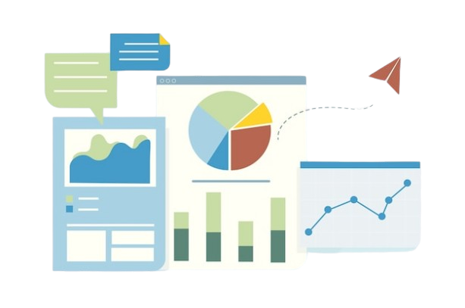
Raw Data & Cleaning Process
To monitor disease spread, recovery, and impact across Indian states using patient data.
Contains columns :-
Patient ID, Name, Age, Gender, State
Disease, Admission & Discharge Dates, Outcome
Issues Resolved :-
Calculated Length of Stay
Created Age Groups: Child, Adult, Senior
Standardized dates & removed anomalies

Slide 4

Pivot Charts Used
To monitor disease spread, recovery, and impact across Indian states using patient data.
The dashboard features five primary pivot charts:
PT1 :- Disease Distribution by State
PT2 :- Disease Cases by Gender
PT3 :- Monthly Disease Trends
PT4:- Recovery vs Death Analysis
PT5:- Disease Spread by Age Group
These charts provide a comprehensive view of disease patterns across demographics, facilitating effective analysis and interpretation of the dataset.

Slide 5
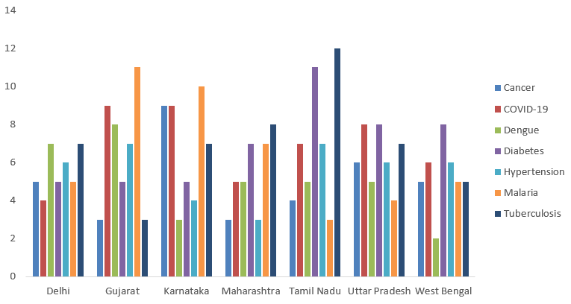
Disease Distribution by State
To monitor disease spread, recovery, and impact across Indian states using patient data.
Purpose:
To visualize which states have the highest and lowest number of disease cases.
Key Insight:
States like [e.g., Uttar Pradesh, Maharashtra] show a higher number of reported cases, indicating a need for better healthcare support.

Slide 6
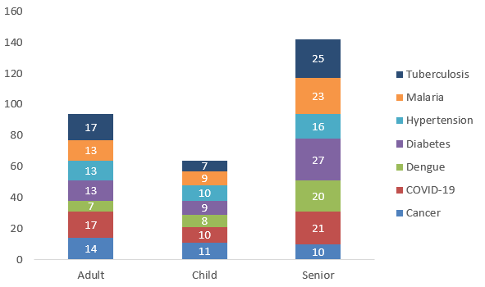
Disease CASES by Age Group
To monitor disease spread, recovery, and impact across Indian states using patient data.
Purpose:
To analyze which age groups are most affected by each disease.
Key Insight:
Children are mostly affected by seasonal illnesses, while seniors show more cases of long-term diseases like Diabetes and Tuberculosis.

Slide 7
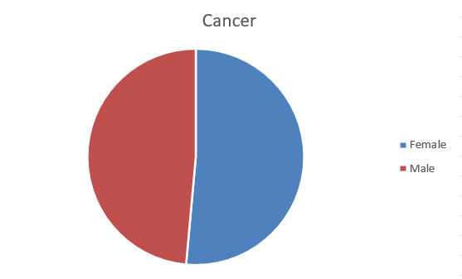
Disease Cases by GENDER
To monitor disease spread, recovery, and impact across Indian states using patient data.
Purpose:
To understand if diseases are affecting males or females disproportionately.
Key Insight:
Helps recognize if certain diseases are more common in a particular gender group.

Slide 8
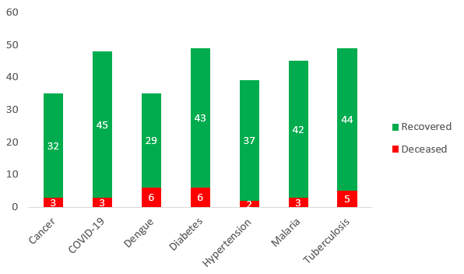
Outcomes: RECOVERY VS DEATH
To monitor disease spread, recovery, and impact across Indian states using patient data.
Purpose:
To compare the number of recovered patients vs those who didn’t survive.
Key Insight:
Majority of patients recovered, but there is a small percentage of critical outcomes in which patients didn’t recover through specific diseases.

Slide 9
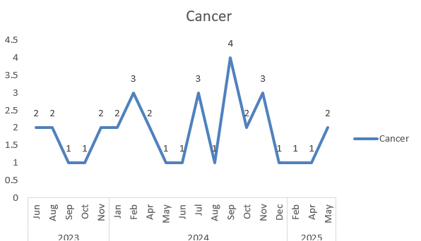
Monthly Disease Trends
To monitor disease spread, recovery, and impact across Indian states using patient data.
Purpose:
To track how disease cases vary over different months.
Key Insight:
Cancer cases peaked in September 2024, showing fluctuating but persistent occurrences over the two-year period.

Slide 10
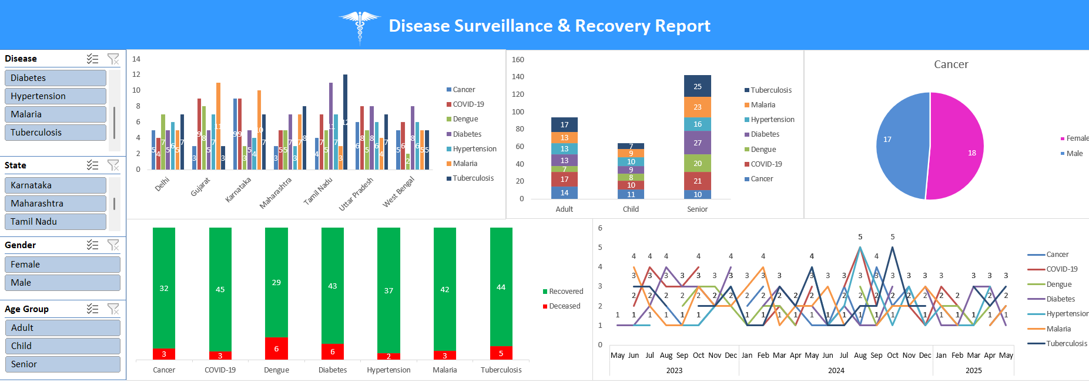
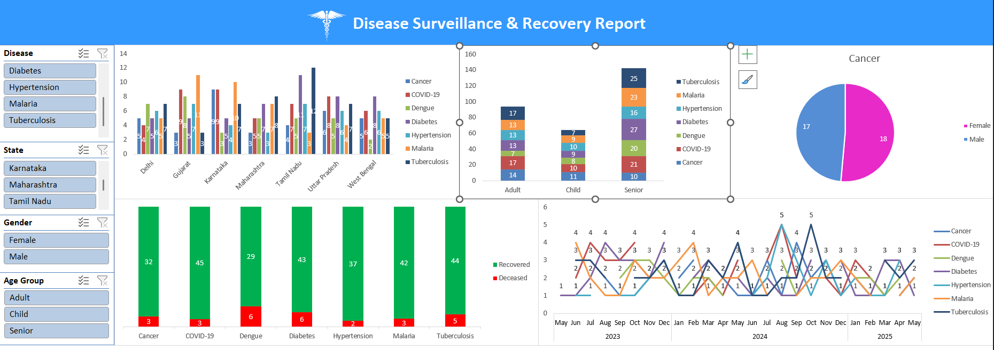
Main Dashboard Highlights
To monitor disease spread, recovery, and impact across Indian states using patient data.
Key visualizations in the dashboard include column charts & its types, pie chart and line chart representing metrics such as Total Patients, Average Stay, and Recovery Rate. Filters allow users to interact with the data, ensuring tailored views for specific analyses or reports.

Slide 11

INSIGHTS & Strategic Implications
To monitor disease spread, recovery, and impact across Indian states using patient data.
Data-driven surveillance empowers timely healthcare response and policy decisions.
Analysis reveals disease spread varies significantly across different states.
Seasonal illnesses mostly affect children, while long-term diseases cause longer hospital stays. This shows the need for focused healthcare efforts based on age and location.

Slide 12
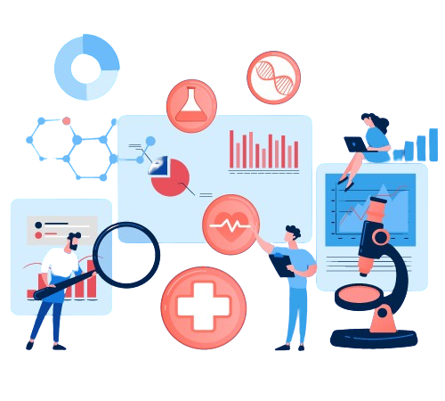
Who Can Use THESE ANAYLSIS?
To monitor disease spread, recovery, and impact across Indian states using patient data.
Government Health Departments for planning and resource allocation.
Hospital for patient trend monitoring.
Researchers & Epidemiologists for disease pattern analysis.

Slide 13
CONCLUSION
To monitor disease spread, recovery, and impact across Indian states using patient data.
Transformed raw patient data into meaningful insights using Excel dashboards.
Identified disease patterns by state, age, and gender for targeted healthcare actions.
Recovery vs. Death trends highlighted areas needing urgent medical focus.
The model is scalable and can be adapted for future disease tracking like COVID-19 or malaria.

Slide 14
THANK YOU ☺
To monitor disease spread, recovery, and impact across Indian states using patient data.

